Slide 1
Cost Containment Solutions
Impairment Solutions TM Program
Mitigating Worker Compensation
Losses through use of proprietary
WP Evaluation Suite
Medical Software producing
Impairment Rating and
Independent Medical Evaluation reports

Slide 2
Worker Compensation Injuries
Worker Compensation injuries can be confusing and often misleading to examiners and physician
At the end of treatment the physician provides an Impairment Rating
Frequently the Impairment Rating is too high for the stated diagnosis by over 80%
There is little or no structure to how doctors perform this critical assessment
This will lead to increased costs if done the wrong way

Slide 3
How was the term Impairment Rating created?
The American Medical Association created the term Impairment Rating in 1950. They then published books to help doctors calculate
an Impairment Rating
This book is called the AMA Guides to Permanent Impairment
There are presently four separate AMA editions mandated and used by 43 states
The AMA Guides (as it is referred to) contains tables, chapters, conversion charts etc. that doctors must use in order to calculate an Impairment Rating which turns into a percentage loss. This percentage is converted to a dollar award.
The “Guides” intention is to provide a standardized process to evaluate the loss of function for a work comp injury
The AMA Guides are confusing and often difficult to interpret, leaving room for many errors to be made by the doctors

Slide 4
The Impairment Rating Problem
Only four states require a doctor to have education on how to perform an accurate Impairment Rating
Frequently examiners are mislead in thinking that all doctors know what they are doing, They do not
Based on statistics of over 5000 cases reviewed, eight out of ten doctors reports contain Impairment Rating mistakes
70% of Impairment Rating mistakes are at least 50% too high, causing an increase in financial payout to claimants, hurting your bottom line
When you control the report, you control the bottom line

Slide 5
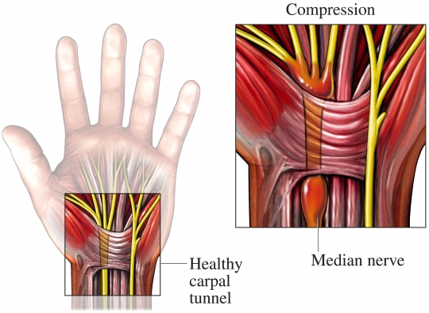
Carpal Tunnel Example

Slide 6
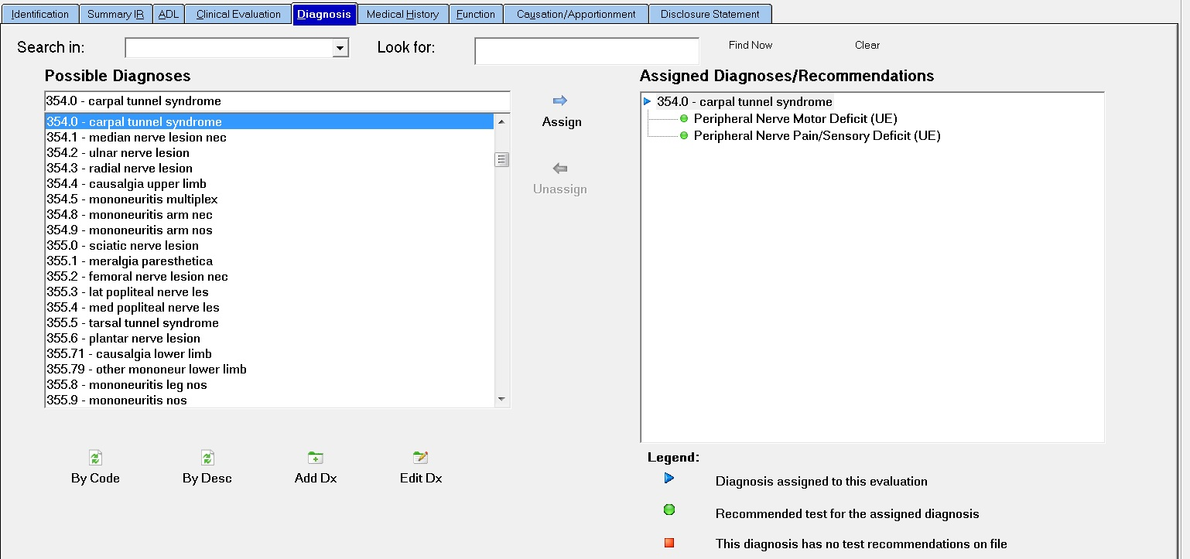
Evaluation Test for Carpal Tunnel

Slide 7
Short summary of mistakes found in Doctors’ reports and the cost of those mistakes
Carpel Tunnel:
58 Cases $172,000 worth of savings
Knee Menisectomy:
46 Cases $75,000 worth of savings
Lumbar ROM:
108 Cases $207,401 worth of savings
Shoulder ROM:
115 Cases $979,395 worth of savings

Slide 8
Cost Containment Solutions offers: AMA Compliant Review™
CCS reviews the report that is being submitted by the doctor
CCS verifies that the report is done in compliance with the appropriate documentation of the AMA Guides to Permanent Impairment
If CCS identifies non compliance, it is documented with reference to each page and chapter of the appropriate Guides to Permanent Impairment
Examiner sends review back to doctor for corrections to be made
The report is used to negotiate a better settlement with either the examiner or the lawyer

Slide 9
Actual Case Reports of Potential Savings
Client # Cases Old Indemnity New Indemnity $ Savings % Savings
Client D 95 $ 928,989.00 $ 307,573.00 $ 621,416.00 67%
Client E 345 $ 1,543,815.00 $ 976,816.00 $ 566,999.00 37%

Slide 10
Actual Case Reports of Potential Savings
Client # Cases Old Indemnity New Indemnity $ Savings % Savings
Client A 369 $ 885,957.00 $ 443,517.00 $ 442,440.00 50%
Client J 53 $ 835,842.00 $ 227,591.00 $ 608,251.00 73%

Slide 11
Why choose Cost Containment Solutions?
Cost Containment Solutions is the only National Impairment
Rating Review Service
Now offering IME’s throughout
the country using
Cost Containment Solutions’
proprietary software
WP Evaluation Suite
The savings and ROI are extraordinary
For pick up of medical records, call us at
1-866-236-4910 ext. 712 or email us at IR@CostContainmentSolutions.com

